Slide 1

Group Name GroupWon
Team Members Destoni Baldwin
Michael Curtis
Jordan Leibman
Zachary Lowery
Troy McMillan
Won Word Processor

Slide 2
Project Overview
We are working on a simple word processor to save us from the dreaded Libre Office.
We are focusing on minimalistic functionality that works well rather than a broad scope of function that performs sub-par at best.
We are creating this program using C#, XAML, and a MVVM programming design pattern.
We believe that using an MVVM pattern is overkill for this project, but it is more desirable than traditional methods.
The majority of our team mates use Visual Studio 2015/2017 for an IDE, and also use Windows 7 – 10 as a design platform.

Slide 3
Key Architectural Drivers
There were three main requirements that drove our design decisions:
It had to be fast.
It had to be responsive.
It had to be up to date.
As an honorable mention, it had to be simple.
It had to be fast, because we needed freedom from Libre’s slow execution speed.
It had to be responsive, because we can’t abide an editor that makes you guess at what it is doing while you’re doing it.
And it needed to be up to date, because processing stale information is pointless.

Slide 4
Architectural Style Choices
There were two potential candidates for our architecture:
Publish-Subscribe.
Layered Systems.
The Publish-Subscribe architecture was a candidate because it allowed for up to date information in a responsive manner due to its event-driven nature.
The Layered Systems approach was considered because it naturally adhered to the typical structure of a word processor as a user-driven piece of software.
We eventually chose the Publish-Subscribe architecture.

Slide 5
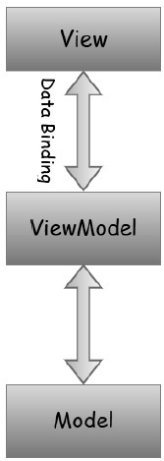
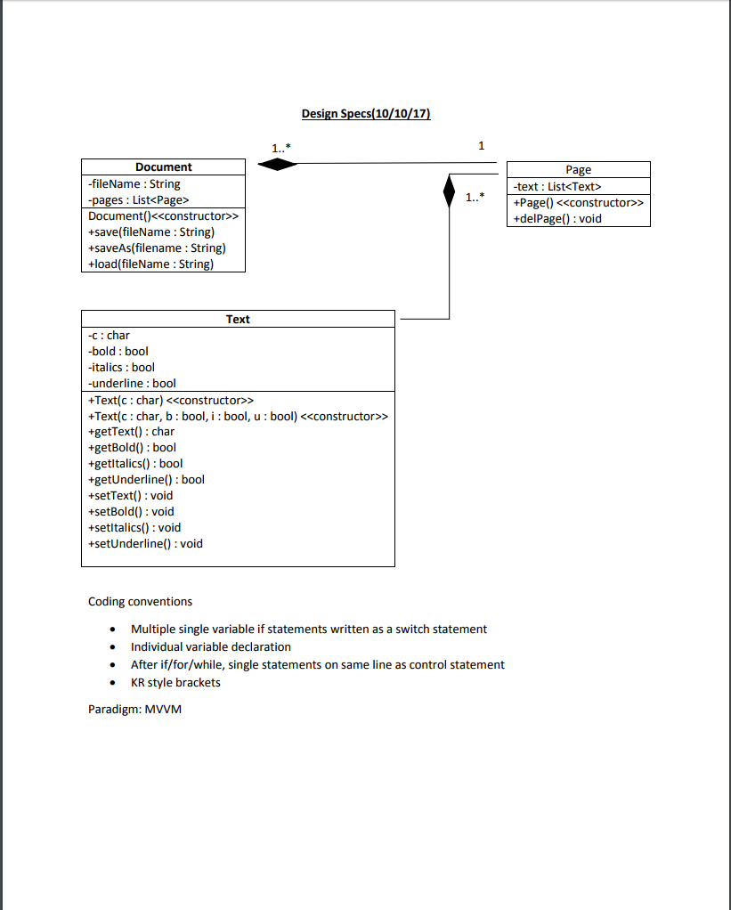
Our Architecture
Typical MVVM Architecture Our Back end (Model)
(Image Courtesy of www.tutorialspoint.com)

Slide 6
Conclusion
We are using a Publish-Subscribe model to capture the necessary aspects of a word processor.
Risks include:
Complexity of development (Publish-Subscribe is hard to test because it is primarily event driven)
Lack of speed, the publish-subscribe architecture doesn’t cater to speed, so we will have to make up for it through minimal, functional design.
Interesting Notes:
During the implementation phase, our lead programmer discovered that C# has certain features and classes that greatly ease development, so our design is undergoing a revamp.
We are discussing using a separate design pattern and are revamping the architecture/implementation as a result.

